Slide 1
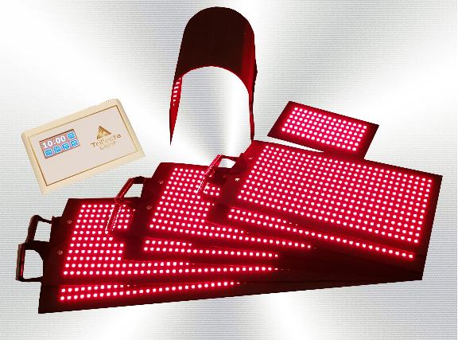
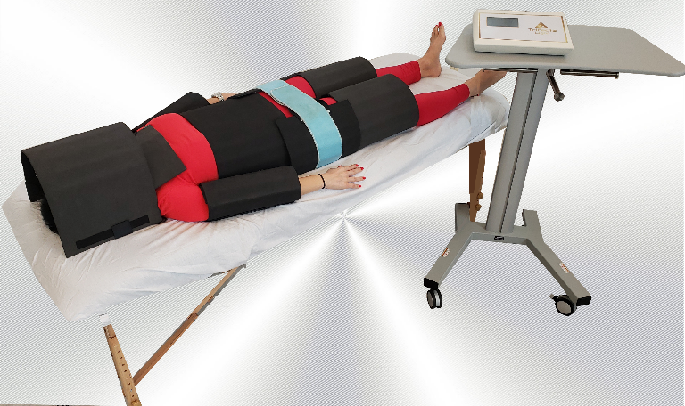
Prices
1 or 2 Regions | 3 of More Regions | Add Face/Chin
1 Session - @ $175 | 1 Session - @ $250 | 1 Session - @ $100
6 Sessions - @ $150 Total is $900 (Savings of $150) | 6 Sessions - @ $225 Total is $1350 (Savings of $150) | 6 Sessions - @ $90 Total is $540 (Savings of $60)
12 Sessions - @ $125 Total is $1500 (Savings of $600) | 12 Sessions - @ $200 Total is $2400 (Savings of $600) | 12 Sessions - @ $80 Total is $960 (Savings of $240)
20 Sessions - @ $100 Total is $2000 (Savings of $1500) | 20 Sessions - @ $175 Total is $3500 (Savings of $1500) | 20 Sessions - @ $70 Total is $1400 (Savings of $600)
Referral Program
After your first visit with us, you will be given referral cards which entitles you to refer others for a courtesy initial visit. When they redeem their voucher, you get an additional free session.

